Slide 1
Secure data hiding in images using steganography
CAPSTONE PROJECT
Presented By: Bourothu Sai Geethika
Student Name :Bourothu Sai Geethika
College Name & Department :Andhra University College of Engineering ( CSE )

Slide 2
OUTLINE
Problem Statement
Technology used
Wow factor
End users
Result
Conclusion
Git-hub Link
Future scope

Slide 3
Problem Statement
With the increasing need for secure communication in today's digital age, traditional encryption methods alone may not suffice to protect sensitive information from unauthorized access and interception. Steganography, the practice of hiding messages within other non-secret texts or data, provides an additional layer of security by concealing the existence of the communication itself. This project aims to explore and implement steganographic techniques to embed secret messages within digital images, ensuring secure and undetectable transmission of sensitive data.

Slide 4
Technology used
Platform:
Python IDLE
Libraries:
OpenCV: For image processing and manipulation.
NumPy: For handling and manipulating image arrays.
PIL (Pillow): For image handling and operations.
Cryptography: For encrypting and securing the hidden messages.

Slide 5
Wow factors
Innovative Techniques: Implementing and showcasing the latest or less commonly known steganography
techniques, such as adaptive steganography or deep learning-based methods.
Robust Security: Demonstrating how the project ensures the highest level of data security and resistance to
various steganalysis attacks.
User-Friendly Interface: Designing a user-friendly application that allows non-experts to easily embed and
retrieve hidden data within images.
Efficiency: Optimizing the algorithm for speed and resource usage, ensuring it works well even on devices with
limited computing power.
Real-World Applications: Highlighting practical use cases, such as secure communication for journalists,
data protection for businesses, or watermarking for digital content creators.
Visual Comparisons: Providing before-and-after comparisons of images to show how imperceptible the hidden
data is.
Detailed Analysis: Offering a comprehensive analysis of the trade-offs between data capacity, image quality,
and security.

Slide 6
End users
Businesses: To protect sensitive information and communications, such as financial data, trade secrets,
and confidential documents.
Journalists and Whistleblowers: To securely share sensitive information without risking exposure.
Government Agencies: For secure communication and protecting classified information.
Digital Content Creators: For watermarking and protecting intellectual property, such as images,
videos, and digital artwork.
Healthcare Providers: To secure patient data and ensure privacy in medical communications.
Educational Institutions: For secure transmission of academic records and research data.
Law Enforcement: To securely share information and collaborate on sensitive investigations.

Slide 7
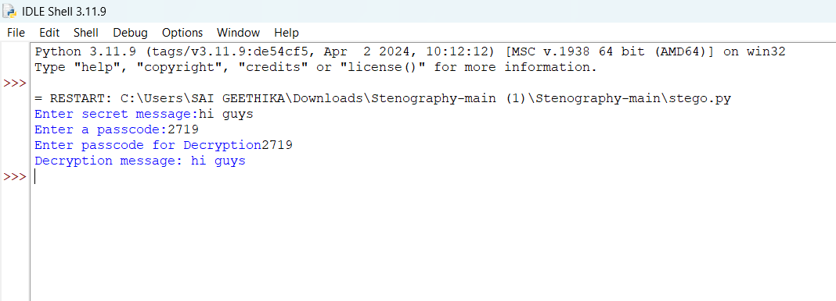
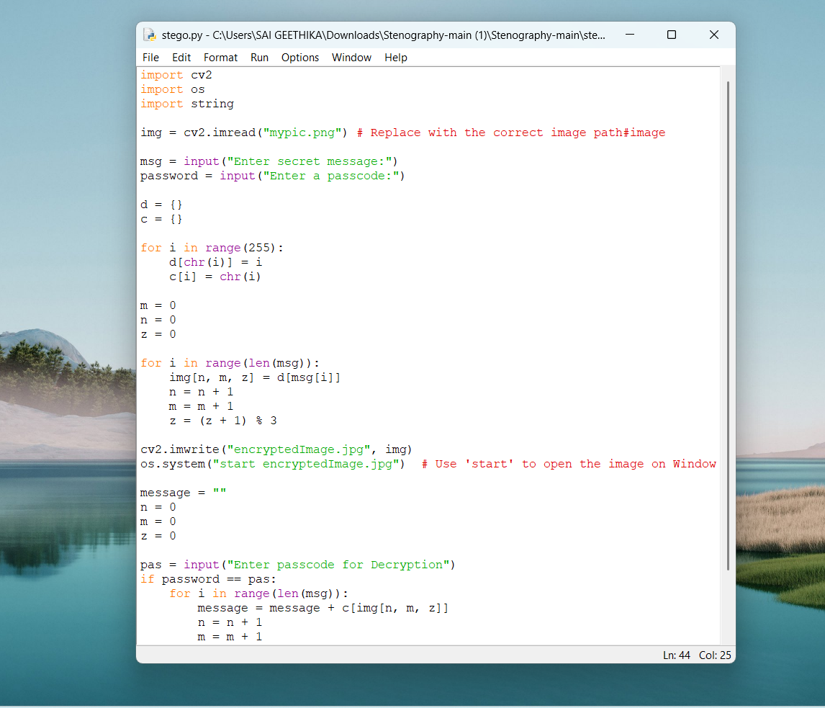
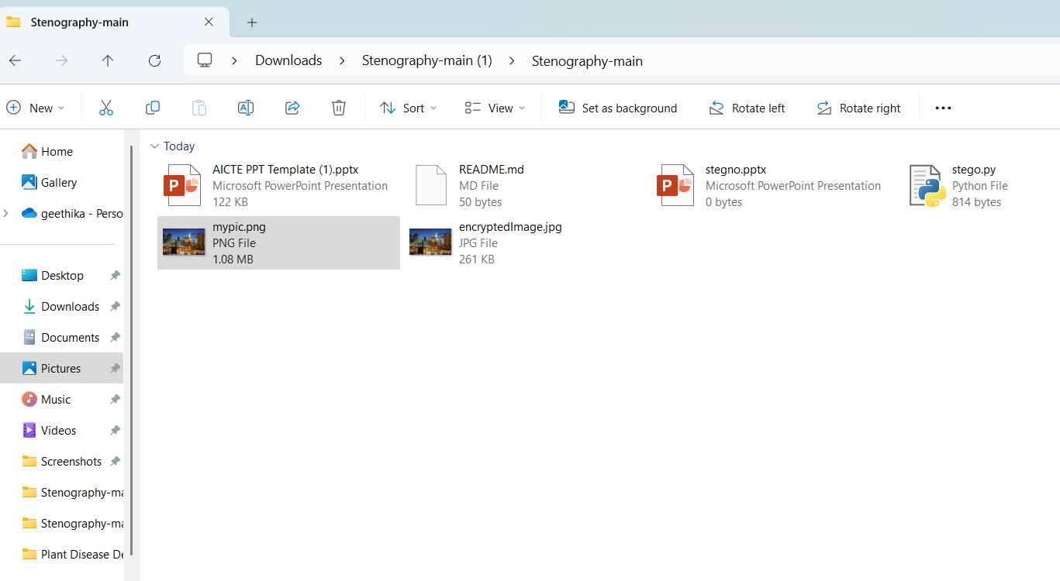
Results
Code and output

Slide 8
Conclusion
This project demonstrates the effective use of steganography to securely hide and retrieve messages within digital images. By utilizing Python and libraries like OpenCV, NumPy, and PIL, we ensure that sensitive information can be transmitted without detection. This method enhances data privacy and security, making it valuable for personal, corporate, and governmental communications. This project showcases the effectiveness of steganography for securely hiding data within images. By leveraging innovative techniques and optimizing for security, capacity, and image quality, we have created a solution that enhances digital communication security for various end users. This project highlights the crucial role of advanced cryptographic methods in protecting sensitive information in today's interconnected world.

Slide 9
GitHub Link
https://github.com/Geethika-27/Secure-data-hiding-in-images-using-steganography.git

Slide 10
Future scope(optional)
Advanced Steganography Techniques: Explore and integrate cutting-edge methods like deep learning-
based steganography or adaptive steganography to improve security and efficiency.
Real-Time Applications: Develop real-time applications for secure communication, such as messaging apps
that use steganography to embed data within images sent between users.
Cross-Platform Compatibility: Ensure the solution works seamlessly across various platforms and devices,
including mobile phones, tablets, and desktops.
Enhanced User Experience: Improve the user interface to make the process of embedding and retrieving
hidden data more intuitive and accessible for non-experts.
Integration with Blockchain: Explore the integration of steganography with blockchain technology for secure
and tamper-proof data transmission and storage.
Multi-Media Steganography: Extend the project to include other forms of media, such as audio and video files,
for more versatile data hiding solutions.
Collaboration with Cybersecurity Experts: Collaborate with cybersecurity professionals to continually assess
and enhance the security of the steganography techniques.
Educational Resources: Develop educational resources and tutorials to raise awareness about the importance
and applications of steganography in data security.

Slide 11
THANK YOU

